Slide 1
ACCURACY IN DESIGN AND MAUNFACTURE

Slide 2
What do we mean by the term tolerance
Why are tolerances important?
What are the benefits of CAD?
Measurement, tolerance, absolute value, exact, precise, variation, range, acceptable, allowance

Slide 3
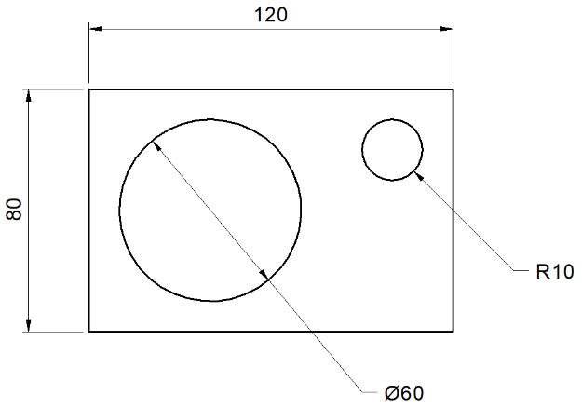
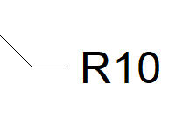
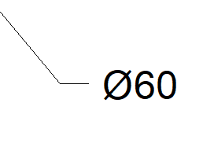
Which units are used in engineering drawings?
What types of measurement are shown?
Measurements are usually in mm
Horizontal
Vertical
Diameter
Radius

Slide 4
What is the allowance made for products/parts/materials to not meet their exact sizing called?
Tolerance
What term is used in engineering to describe the exact size?
Absolute

Slide 5
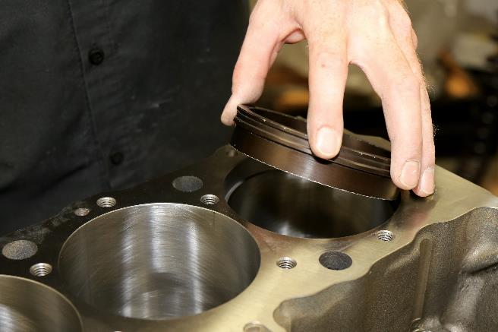
Why is working within tolerance important?
-Creating components to exact measurements (absolute) is expensive.
-Machining processes often introduce variation in measurements.
-It is important to set the acceptable variation in measurement.
-The fit of the part can be assured.
-Manufacturers and consumers can have confidence in the part/product.

Slide 6
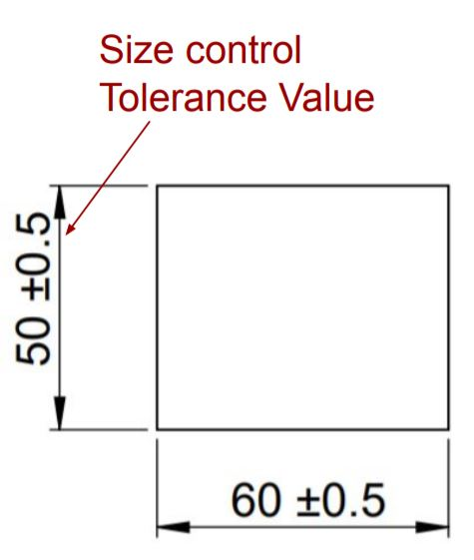
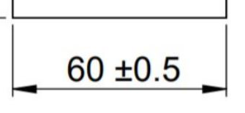
How are tolerances shown on engineering drawings?
= Tolerance is

Slide 7
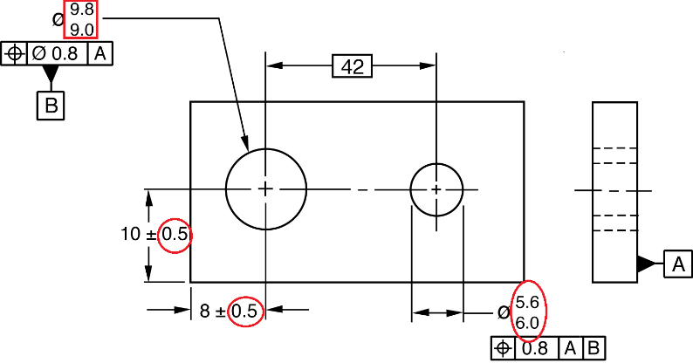
How are tolerances shown on engineering drawings?

Slide 8
How do we solve the tolerance?
Absolute measurements
Tolerances
Allowed ranges…
10mm
0.2mm
9.8mm – 10.2mm
100mm
0.5mm
99.5mm – 100.5mm
2mm
0.1mm
1.9mm – 2.1mm

Slide 9
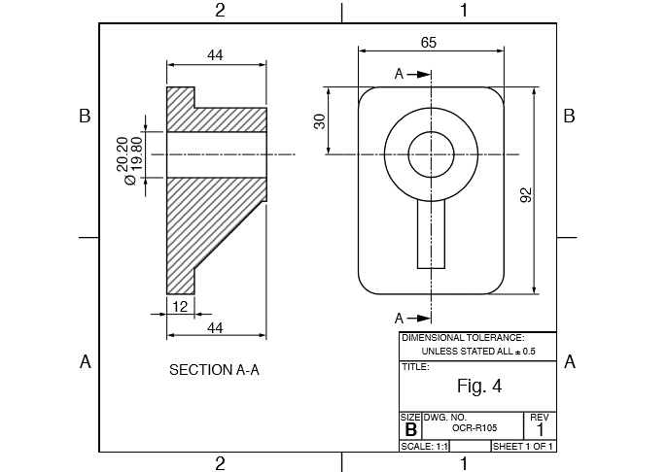
How will you be tested in the exam?
This is a specific tolerance
This is a general tolerance

Slide 10
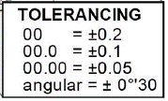
What if there is more than one tolerance?
No decimal places
1 decimal place
2 decimal places

Slide 11
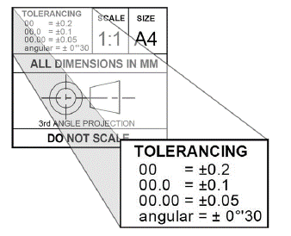
How are tolerances shown on engineering drawings?
So… a measurement of…
10mm would have a tolerance of…
(no decimal places)
=9.8mm to 10.2mm
No decimal places

Slide 12
How are tolerances shown on engineering drawings?
So… a measurement of…
10.5mm would have a tolerance of…
(one decimal place)
=10.4mm to 10.6mm
1 decimal place

Slide 13
How are tolerances shown on engineering drawings?
So… a measurement of…
2 decimal places
10.15mm would have a tolerance of…
(two decimal places)
=10.10mm to 10.20mm

Slide 14
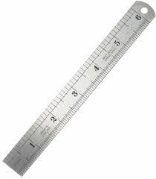
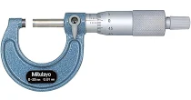
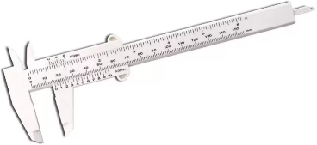
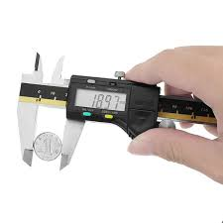
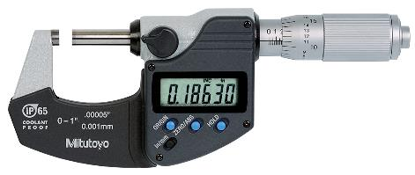
What are these measuring tools called?
micrometer
vernier caliper
Steel rule
Digital vernier
digital micrometer
Digital vernier / micrometer / vernier caliper / digital micrometer / steel rule
Using the vernier scale link

Slide 15
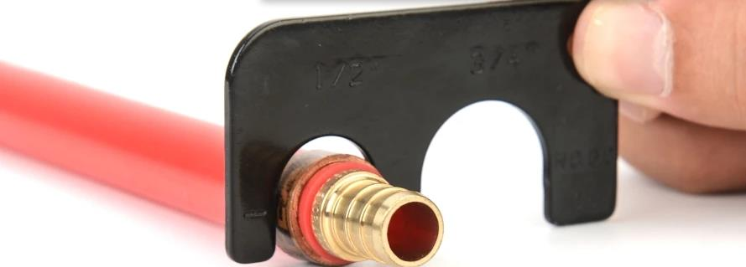
What is this device called?
Go-no-go gauge

Slide 16
How do we use a go-no-go gauge?
Which of these parts is the correct size?
A
B
C

