Slide 1
COMPUTER AIDED MANUFACTURE

Slide 2
What is CAM?
What are the common examples of CAM ?
What are the advantages of CAM?
How is CAM used in engineering?
What does CNC mean?
CAM, CNC, Router, lathe, milling machine, vinyl cutter, laser cutter, 3D printer

Slide 3
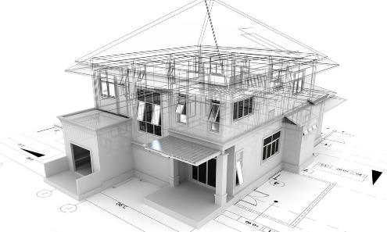
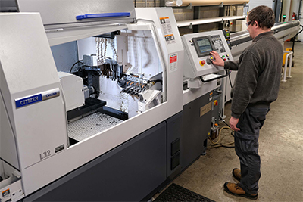
What are CAD and CAM ? Can you remember?
CAD
CAM
Computer Aided Design
Computer Aided Manufacture

Slide 4
How is CAM used in engineering ?
Laser cutting
CNC routing
What are examples of CAM?
Vinyl cutting
3D printing
CNC milling
CNC turning

Slide 5
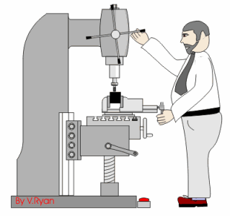
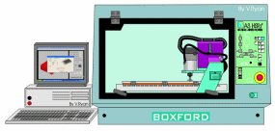
Manual vs Computer controlled
VS
-Manual control
-Time consuming
-Slower
-Harder reproduce items
-Automated
-Less labour intensive
-Can produce identical components
-Accurate

Slide 6
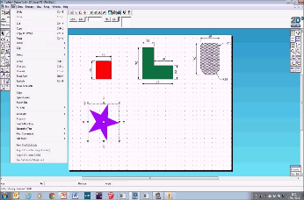
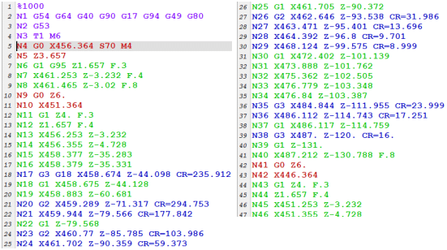
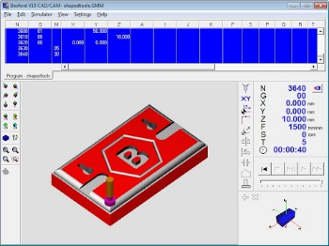
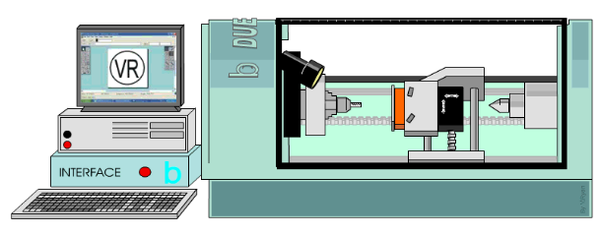
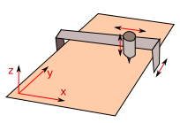
What is CNC?
Computer software
Computer Numerical Control
Interface
Machine

Slide 7
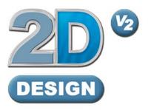
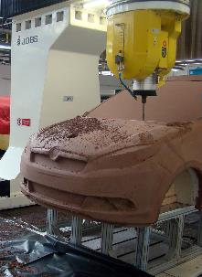
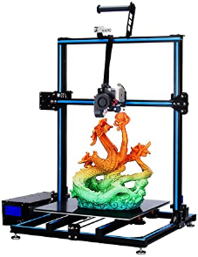
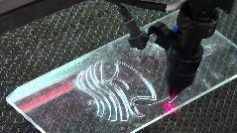
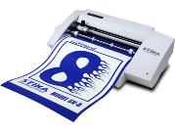
Preparing to use CAM?
2D
Computer
Aided
Design
3D
Which processes are used with each type of software?
CNC milling
3D printing
Laser cutting
Vinyl cutting

Slide 8
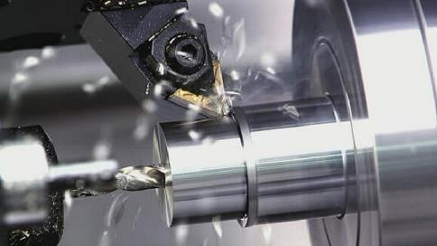
VS
Subtractive or Wasting processes
Additive
processes
Material is removed to form the model
Material is added
To form the model
Turning
3D printing
Can you think of any other examples?
Cutting, drilling, filing etc.
Clay modelling/paper-mache

Slide 9
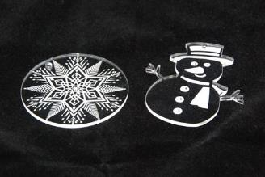
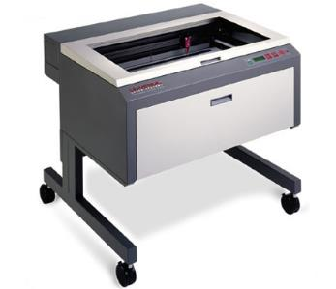
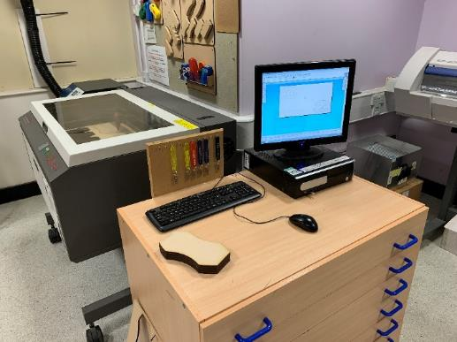
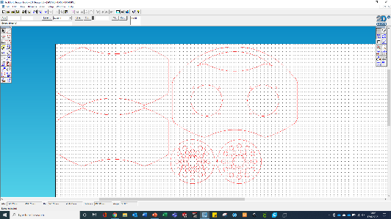
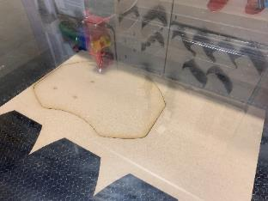
How is Computer Aided Manufacture used in engineering?
Laser cutting
-Cuts and engraves plastics, wood, card etc.
-Uses an intense beam of light
-Suitable for flat/sheet materials
-Zero cut thickness
VIDEO LINK

Slide 10
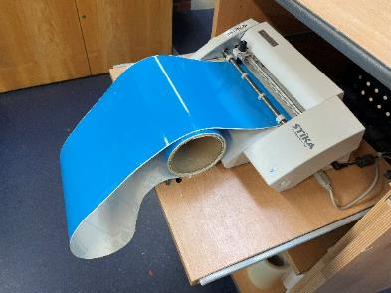
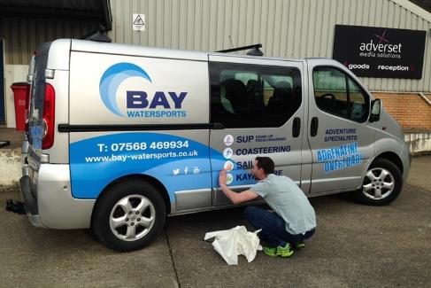
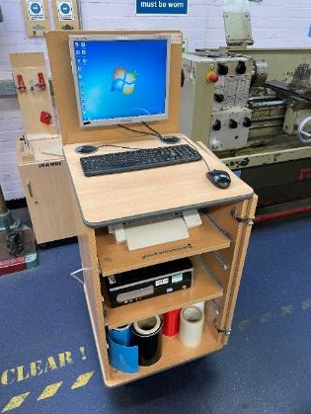
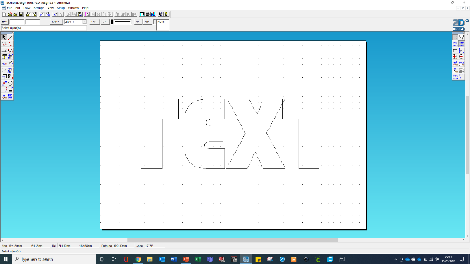
How is Computer Aided Manufacture used in engineering?
Vinyl cutting
-Cuts vinyl, card and paper
-Uses a moving cutter/blade
-Ideal for producing signs
VIDEO LINK

Slide 11
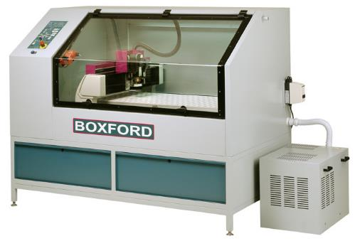
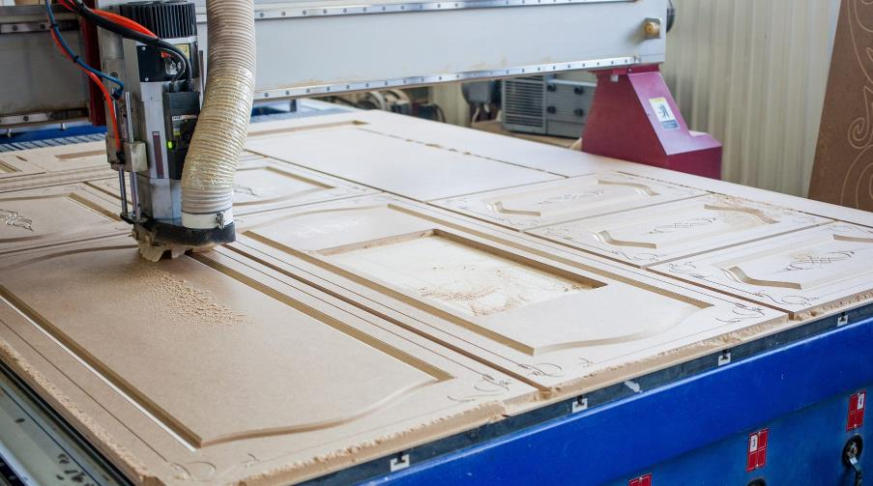
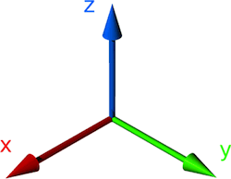
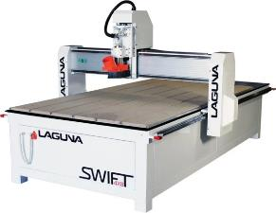
How is Computer Aided Manufacture used in engineering?
CNC routing
-Used to cut wood, sheet materials
-Uses a spinning cutter
-The work is clamped (stationary)
-The cutter moves (x,y,and z)
VIDEO LINK

Slide 12
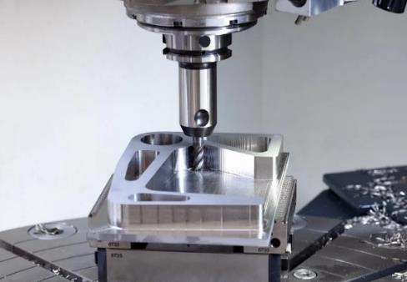
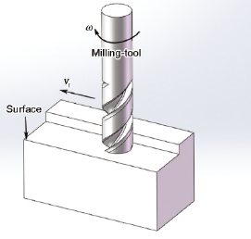
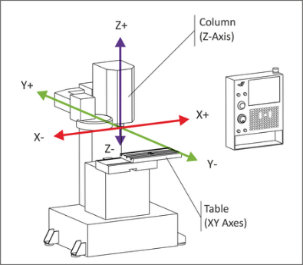
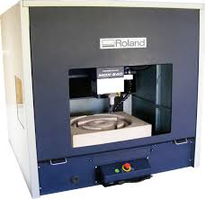
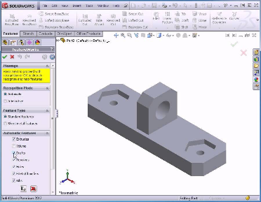
How is Computer Aided Manufacture used in engineering?
CNC milling
-Cuts metals and plastics
-Uses a spinning cutter
-Work is clamped to a moving table
-The table moves during cutting (x,y,z)
VIDEO LINK

Slide 13
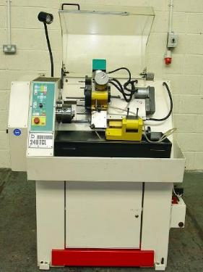
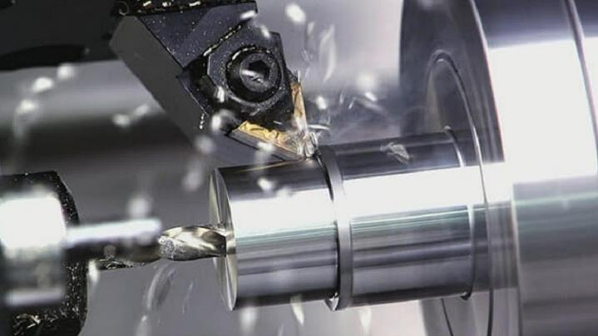
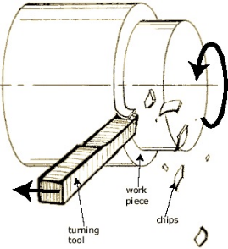
How is Computer Aided Manufacture used in engineering?
CNC turning
-Used to cut metal and plastics
-Work is held in a spinning chuck
-Creates cylindrical shapes
-The tool moves to make the shape (x,y)
VIDEO LINK

Slide 14
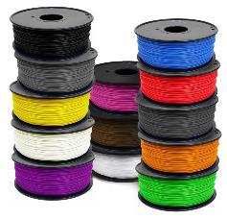
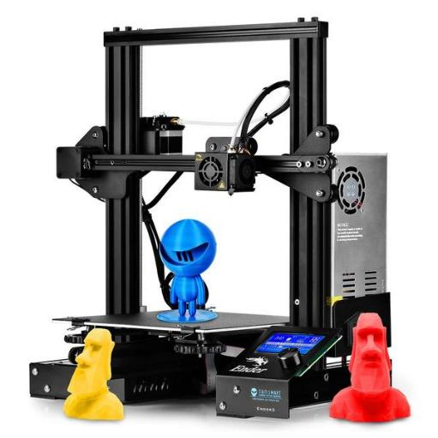
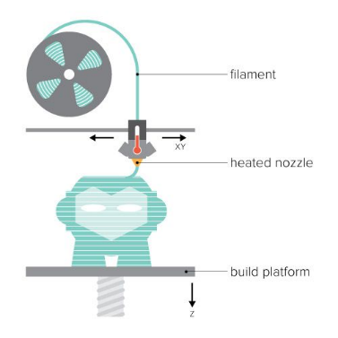
How is Computer Aided Manufacture used in engineering?
3D Printing
-Can produce complex 3D shapes
-Melts plastic filament
-Builds layers of plastic
VIDEO LINK

Slide 15
What can you remember about CAM?
Have a go at the quiz to check your understanding…
https://htrevisionzone.site/l2_engineering_using_cam/index.html

