Slide 1
ERGONOMICS AND ANTHROPOMETRICS

Slide 2
What are the needs of the user?
What factors do we need to consider when designing?
Why is inclusive design important?
How can we design more inclusive products?
Ergonomics, anthropometrics, inclusive design, percentile, comfort

Slide 3
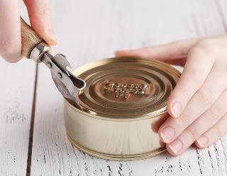
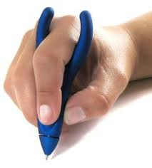
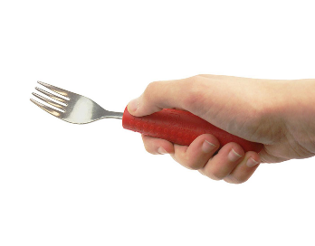
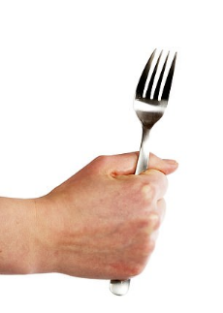
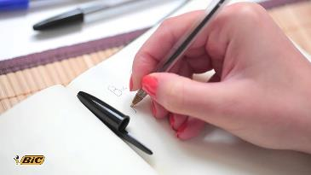
Which of the following products do you think would be the most user friendly?

Slide 4
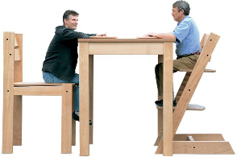
What is ANTHROPOMETRICS ?
Anthropometrics is the study of the sizes of people in relation to products.
For example, chairs used in schools need to be suitable for the average size of pupils.
What is ERGONOMICS ?
The study of people and their relationship with the environment around them. Designing according to the needs of the user/customer.

Slide 5
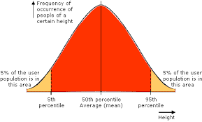
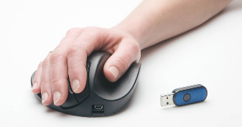
How are products designed for the masses?
We would need to collect anthropometric data on peoples hand measurements..
We would then need to know the measurements of the larger and the smaller user hand size…
this is called the 5th and 95th percentile.
If we wanted to design a computer mouse that ‘most’ people could use easily..
We would then design our product to suit the remaining 90%.
This means that you’re designing for the vast majority of the population and leaving very few out.

Slide 6
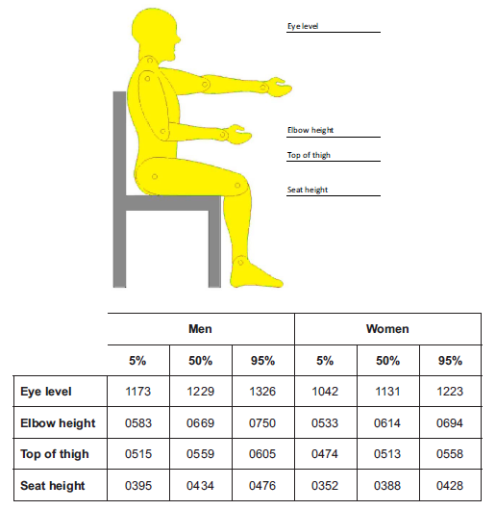

Slide 7
How is anthropometric data used in product design?
If you were designing an adjustable computer desk, what would be the maximum and the minimum seat height you would allow it to be adjusted to?
First look at the tallest (or the 95% percentile) sitting height..
Then look at the shortest (or the 5th percentile) sitting height…
Therefore when designing, the maximum it should be adjusted to is 0476mm an the lowest it should adjust to is 0352mm.

Slide 8
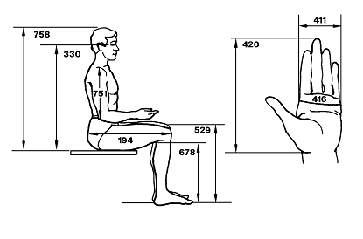
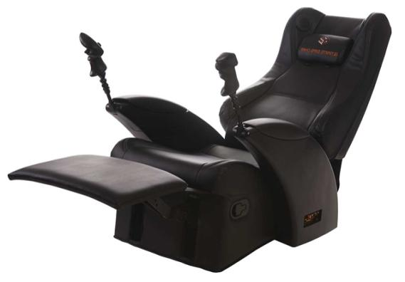
How is anthropometric data used in design?
We would use this
ANTHROPOMETRIC data…
to be able to design this ERGONOMIC gaming chair

Slide 9
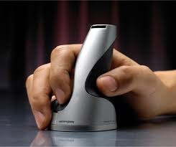
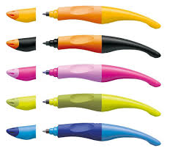
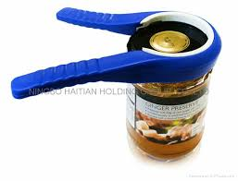
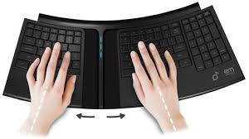
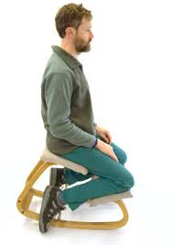
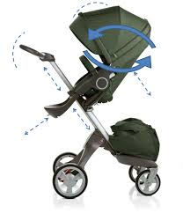
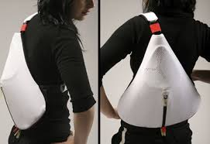
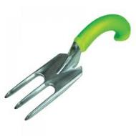
How are ergonomics used in design?
Designers look at the way the products are used and how they can be designed to have maximum comfort when in use.

Slide 10
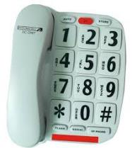
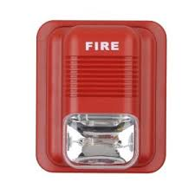
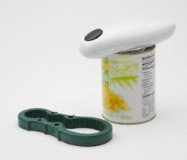
How can we design products to be inclusive?
The ideal product is one that meets everyone's needs. It is sometimes impossible! However, we should always try to design products that exclude as few people as possible. Physical ability, health, intellect are all human factors that designers need to consider.
Big button phone for people that are visually impaired
Flashing fire alarm for people that have hearing impairments
Entrance ramps for wheel chair users and people that find walking difficult
Electric can opener and holder for people with arthritis
Braille mobile phone for blind people

Slide 11
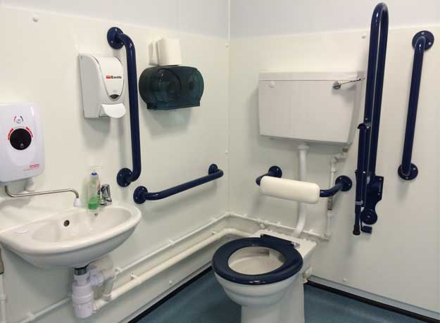
How can we design products to be inclusive?

Slide 12
What can you remember about ergonomics and anthropometrics?
Have a go this short quiz to see how well you have understood the topic…
https://htrevisionzone.site/a_level_ergonomics_and_anthropometrics/index.html

