Slide 1
METAL PROCESSES

Slide 2
What are the metal shaping processes?
How are the metal shaping processes carried out?
What are the applications of the metal shaping processes?
Shaping, forming, cold forming, redistribution processes, hot forming, batch production, mass production

Slide 3
-Contain iron
-Rust
-Don’t contain iron
-Don’t rust
Ferrous
Non-Ferrous
What categories are metals divided into?
Non-Ferrous Alloys
Ferrous Alloys
-Combination of two or more non-ferrous metals
-Combination of two or more metals
-Include a ferrous metal
-Addition of non ferrous metals
Cermets
-Composite material
-Ceramic (cer) + metal (met)

Slide 4
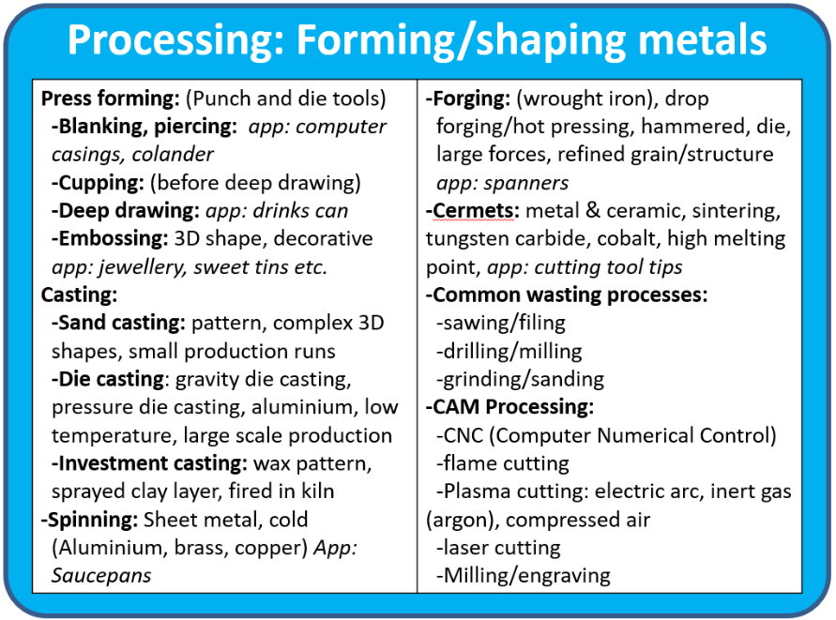
What resources are there to help me?
www.htdesigntech.com (password: htmember)

Slide 5
What are the categories of metal shaping process?
Hot metal shaping
Cutting processes
Metal shaping processes?
Casting processes
Sheet metal processes

Slide 6
Plasma cutting
Laser cutting
What are the cutting processes?
Milling
Turning

Slide 7
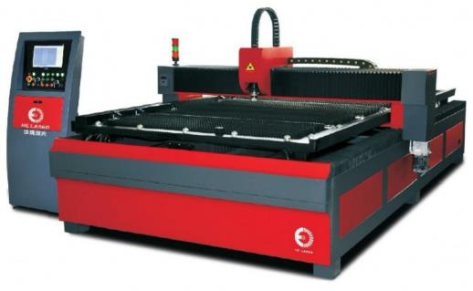
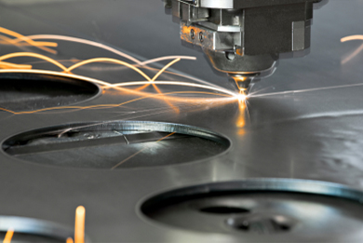
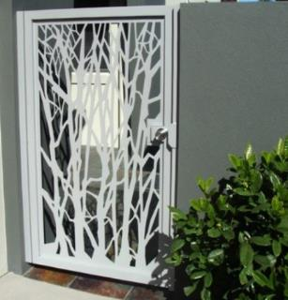
What is the laser cutting process?
VIDEO

Slide 8
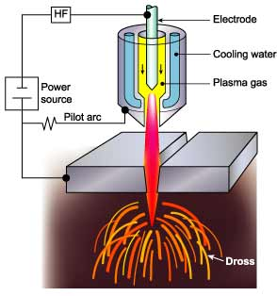
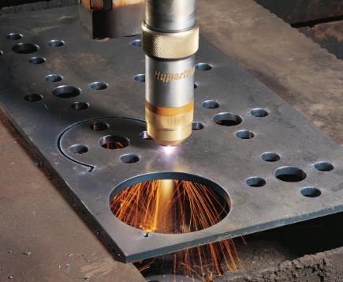
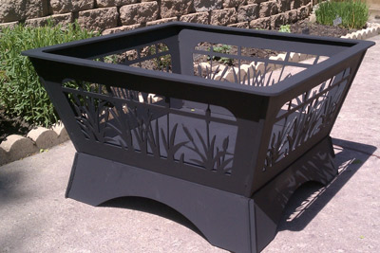
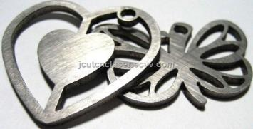
What is plasma cutting?
VIDEO

Slide 9
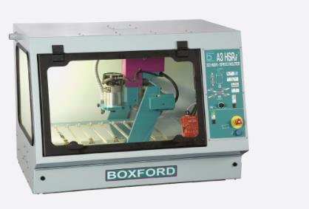
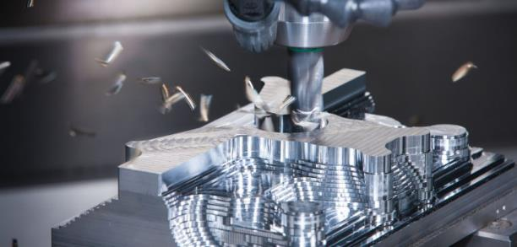
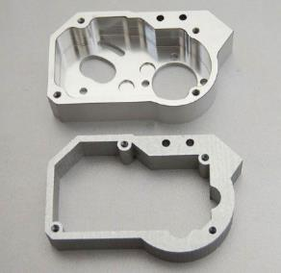
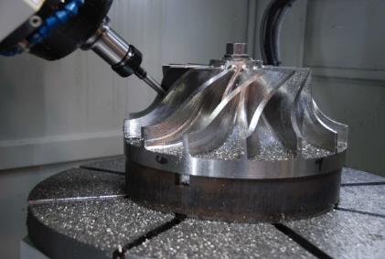
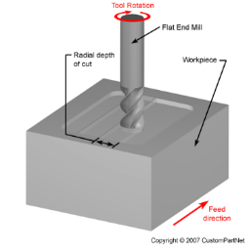
What is milling?
VIDEO

Slide 10
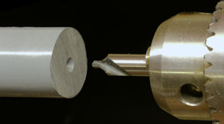
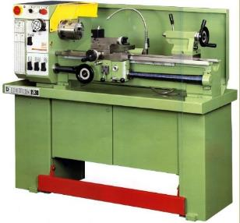
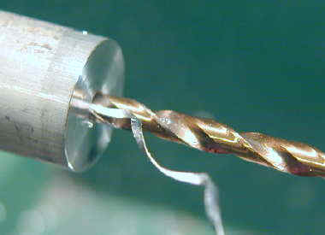
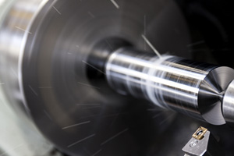
What is the laser cutting process?
VIDEO

Slide 11
Rolling metal
Forging
What are the hot metal shaping processes?
Casting

Slide 12
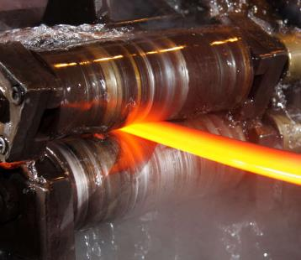
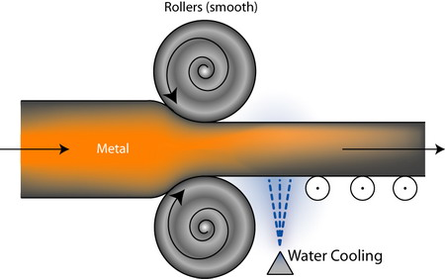
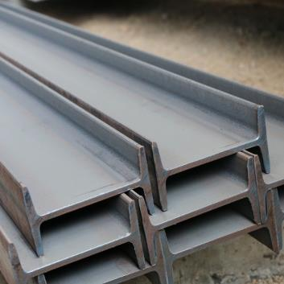
What is rolling metal?
VIDEO

Slide 13
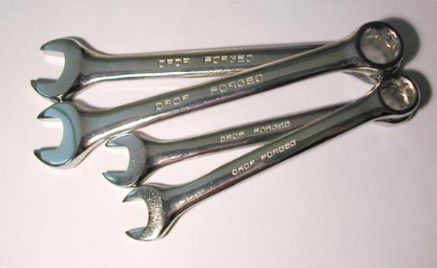
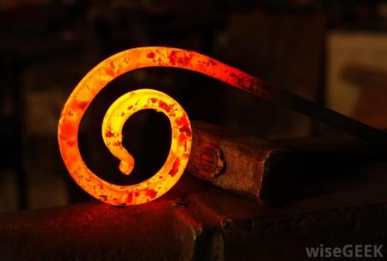
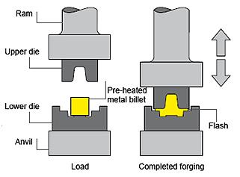
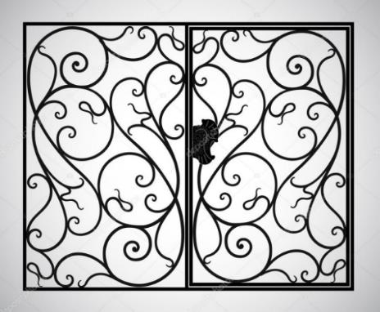
What is forging?
VIDEO

Slide 14
Sand casting
Investment casting
What are the different casting processes ?
Pewter casting
Die casting

Slide 15
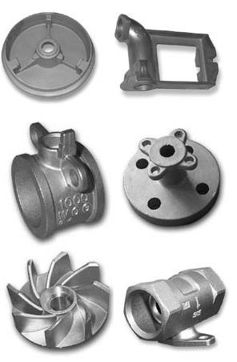
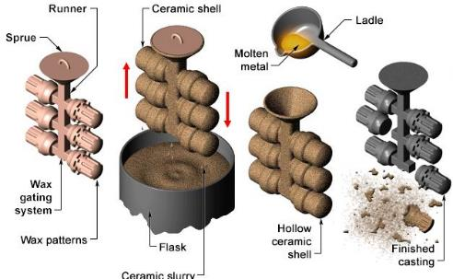
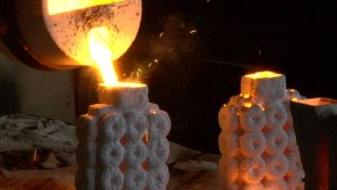
What is investment casting?
VIDEO

Slide 16
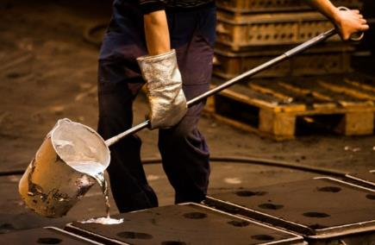
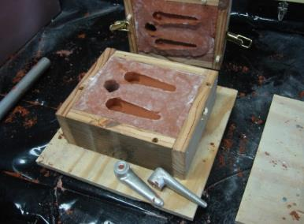
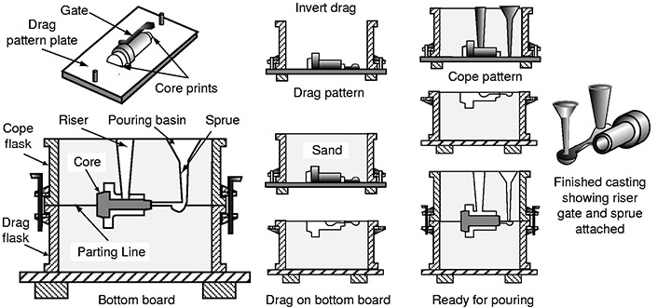
What is sand casting?
VIDEO

Slide 17
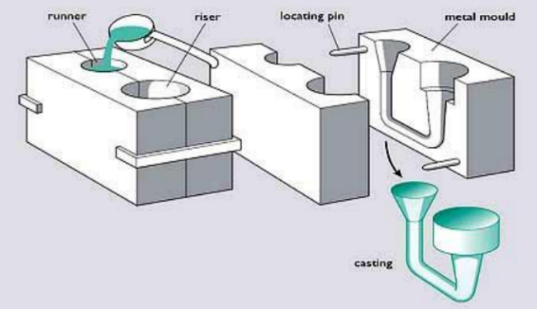
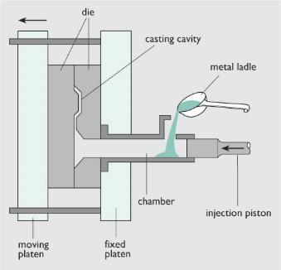
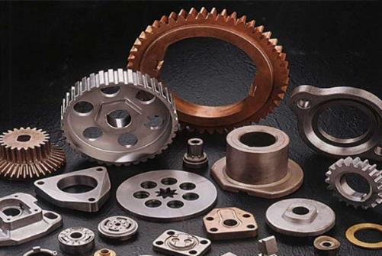
What is die casting?
VIDEO

Slide 18
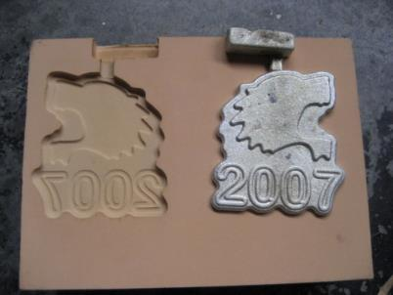
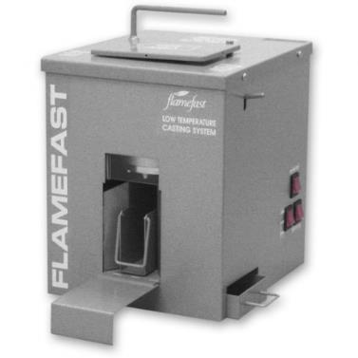
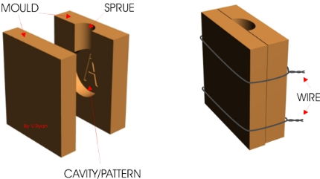
What is pewter casting?
VIDEO

Slide 19
What are cold forming processes?
Piercing
Pressing
What are the sheet metal forming processes?
Drawing
(deep drawing)
Cupping
Spinning

Slide 20
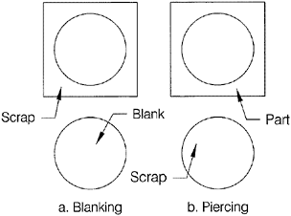
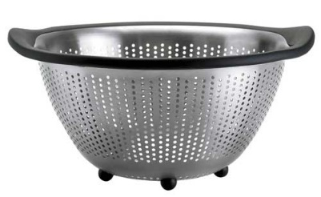
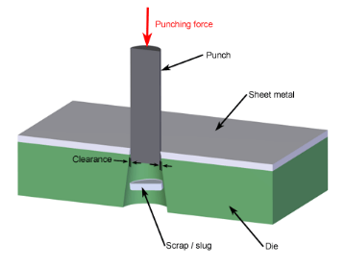
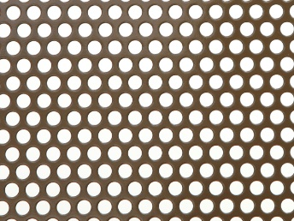
What is metal piercing?
VIDEO

Slide 21
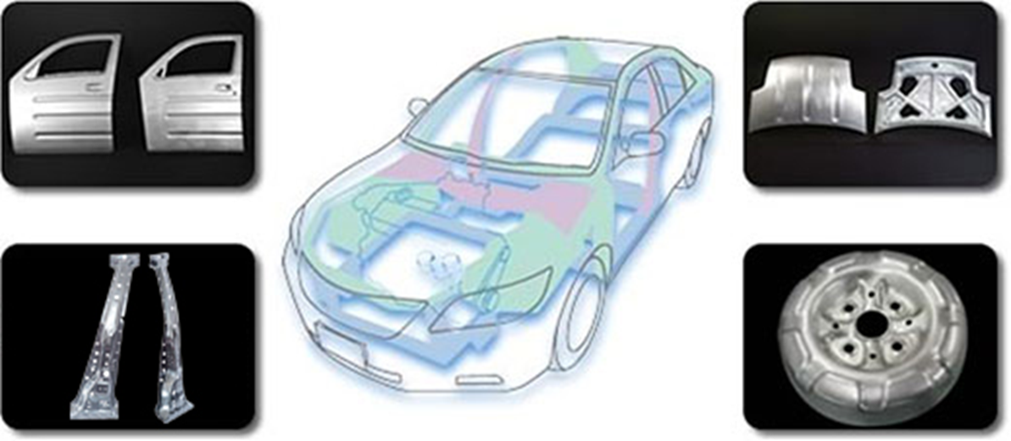
What is the pressing process?
VIDEO

Slide 22
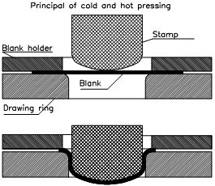
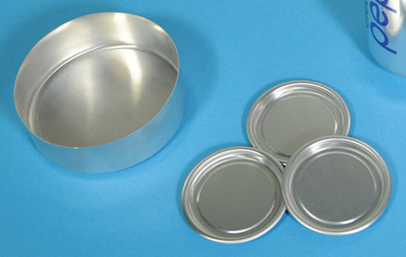
What is cupping process?
VIDEO

Slide 23
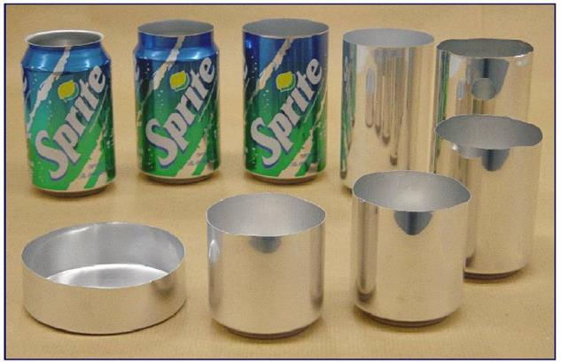
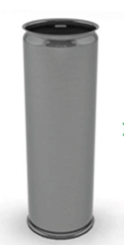
What is the drawing process?
VIDEO

Slide 24
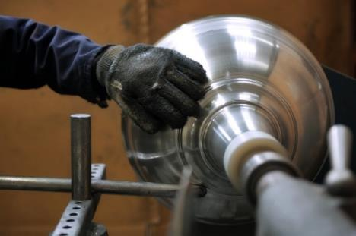
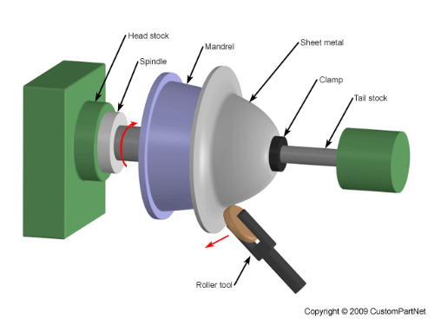
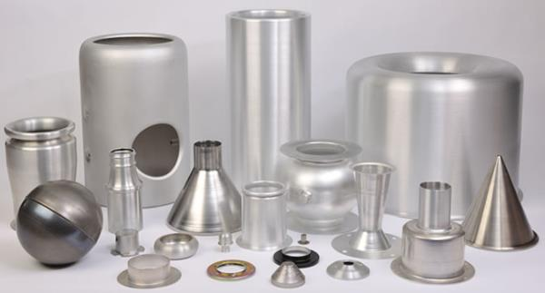
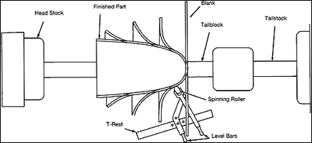
What is metal spinning?
VIDEO

Slide 25
Click on the link below to have a go at this short quiz to check your understanding of the metal processes…
http://www.htrevisionzone.site/a_level_metal_shaping_processes/

Slide 26
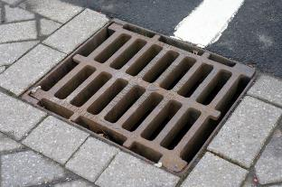
Here are a number of products made from metals.
Laser cut aluminium
Sand cast drain grate
Rolled steel beam
Which metal processes have been used to shape these products?
Pierced colander
Forged gate
Drawn aluminium can

