Slide 1
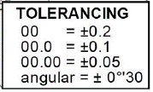
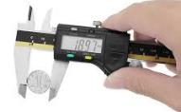
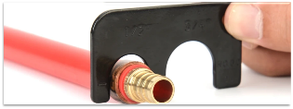
Unit R105 – Accuracy in design and manufacture revision task
1. All measurements in engineering drawings are shown in what units? Circle the correct unit.
5. Here is a simple dimensioned drawing…
7. Why are tolerances used on dimensions in engineering drawings?
8. What do we mean by absolute size?
What would the minimum and maximum sizes of this measurement be?
inches
m
cm
mm
feet
2. Can you add a horizontal and vertical dimension to this rectangle?
Min size
Max size
6. Here is the tolerance information from a working drawing…
9. What are parts not normally made to absolute size?
10. The pictures below show two measuring tools. What are they called?
3. Can you add a radius dimension to this circle?
What would the minimum and maximum sizes of the measurements shown below be?
11. The device shown here is called a go-no-go gauge. Why is it used?
Min size
Max size
4. Can you add a diameter dimension to this circle?
12. The diagrams below show a tube being tested with a go-no-go gauge. Which is the correct sized part? A,B or C?
Min size
A
B
C
Max size

