Slide 1
INFLUENCES ON DESIGN

Slide 2
 | UNIT R105 TOPICS
1 | The phases of the design cycle
2 | Exploring the design cycle
3 | Influences on product design
4 | Product requirements
5 | Scales of production
6 | Stock forms and components
7 | Durability and tolerances
8 | Engineering drawings
9 | Engineering standards and symbols
10 | Environmental issues
11 | Using CAD in engineering
12 | Using CAM in engineering
13 | New and emerging materials
Which topic will be exploring in today’s lesson?

Slide 3
How/why do products evolve?
What is market pull?
What is technology push?
What are examples of market pull and technology push?
Evolution, technological advancements, demand, obsolescence, fashions, trends

Slide 4
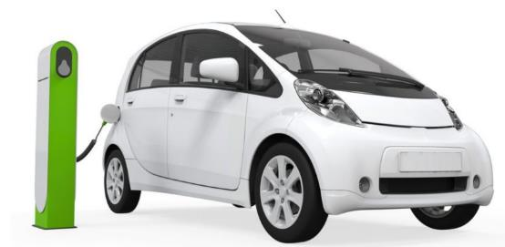
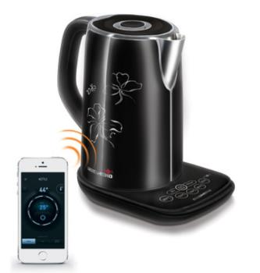
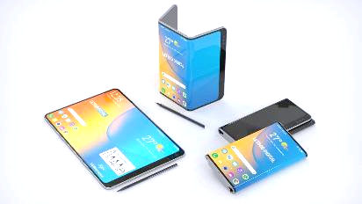
Why do people buy new things?
To keep up to date with new technology
To get a more efficient product
To keep up with fashions and trends
To replace a broken product
To replenish a product
To benefit from new advancements

Slide 5
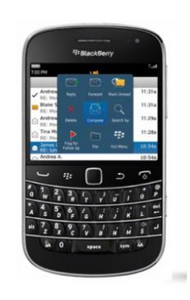
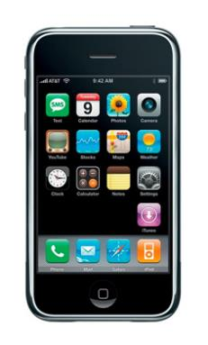
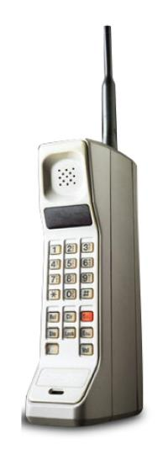
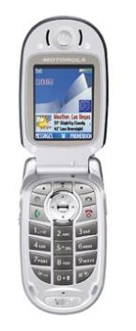
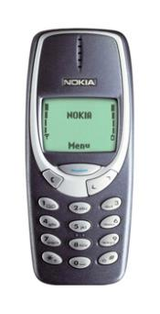
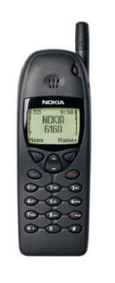
Can you put these mobile phones in the order they were released?

Slide 6
Can you put these mobile phones in the order they were released?
Why has the mobile phone changed over the years?

Slide 7
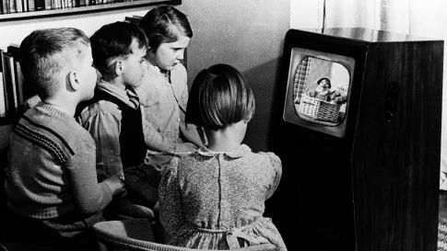
What is product evolution?
How has the way we watch TV changed?
Why do products evolve?

Slide 8
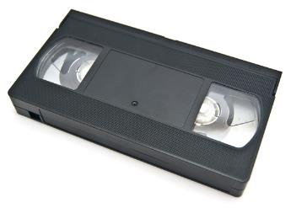
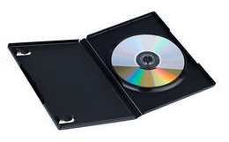
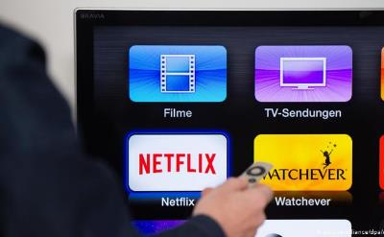
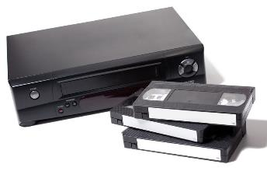
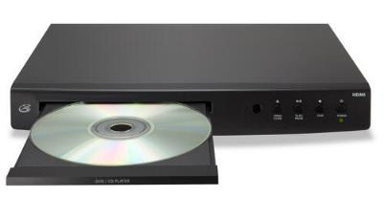
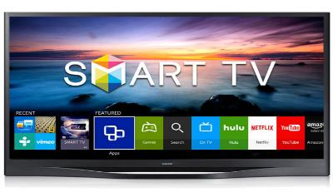
What is the impact of product evolution?
How have these products evolved?
Video cassette
DVD (Digital Video Disc)
Streaming films
Video recorder
DVD player
SMART TV

Slide 9
What is market pull?
-Consumer demand drives the development of new products to meet the new need.
-Market research usually helps define what the product will do and how it will perform.
-This could arise from a problem/need in the market which manufacturers try to meet…

Slide 10
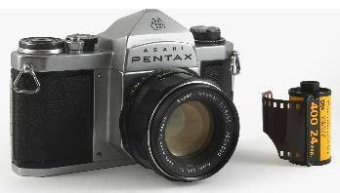
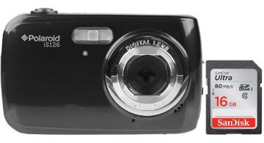
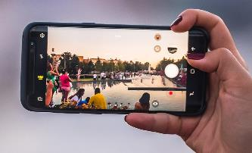
What is an example of market pull?
How many photographs did consumers originally expect to take with the first cameras?
What do we expect from our modern cameras?
A typical film held 35 shots
Early memory cards could hold 100’s of images. But consumers demanded bigger capacity and more storage.
Consumers now expect their smart phones to hold thousands of images and video.

Slide 11
What is technology push?
-Advancements in technology drive forward the development of new products.
-Frequent releases of new, upgraded products encourages consumers to replace their current product.

Slide 12
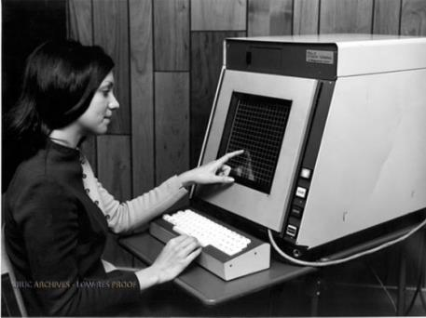
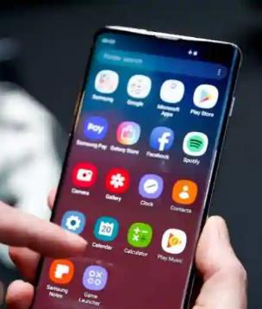
What is an example of technology push?
Can you think of an example?
This technology was first used in air traffic control systems over 50 years ago.
In 2007 it revolutionised the design of the mobile phone…
The touchscreen is a good example!

Slide 13
How has technology push changed the way we listen to music?
What came next?...
Vinyl record
Cassette tape
Compact Disc
MP3
Streaming services

Slide 14
How do companies continuously improve their products?
What is R & D?
Companies invest a lot of money into
Research and Development to remain market leaders.

Slide 15
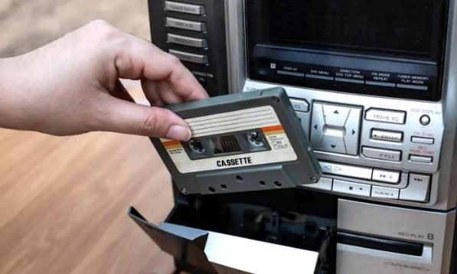
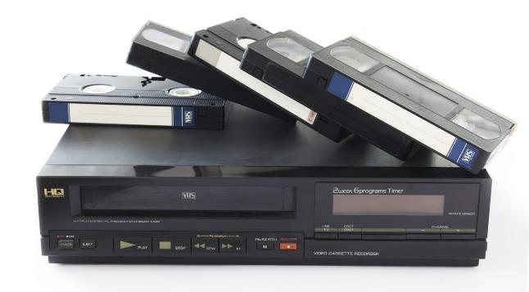
What do we mean by the term obsolete?
When a product is no longer useful or has been replaced by newer, better technology.
Can you think of any examples?
Audio cassette tape
Video cassette tape

Slide 16
How do market pull and technology push lead to product development?
Technology push
Research and development
Production
Marketing
Need?
Market pull
Research and development
Production
Marketing
Expressed market need

Slide 17
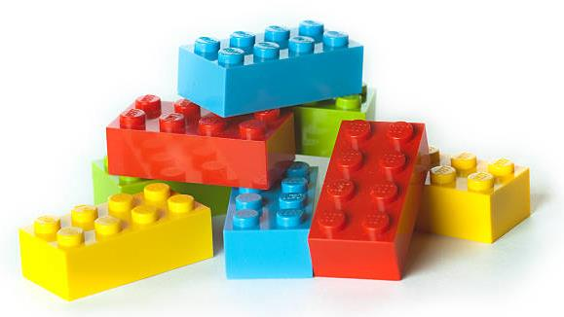
What is an iconic design?
These are products that have become extremely popular and are examples of excellent design.
These well known products can often be recognised world-wide.
Can you guess this example? Here are some clues…
-A child’s toy
-Sold in many shapes, sizes and colours
-You can build many different things with it
-There are many copies but this was the original

Slide 18
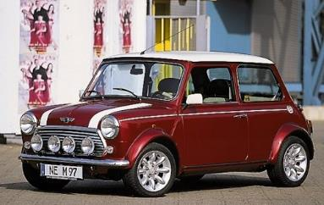
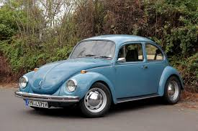
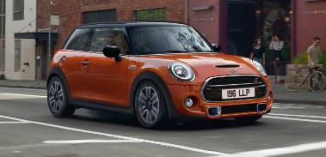
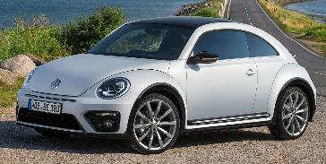
What makes a product iconic ?
“Ground breaking design”
Sets new standards of design
Memorable
Widely recognised
Innovative
Stood the test of time
Mini
(Designed by Alec Issigonis)
Volkswagen Beetle
(People’s car)
Do you recognise these examples…

Slide 19
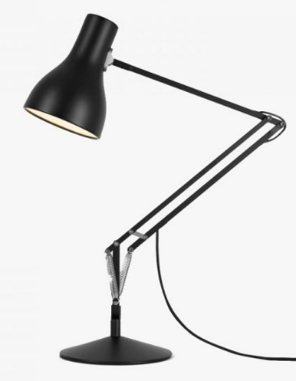
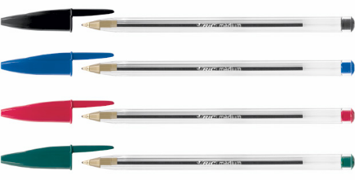
Can you think of any other iconic products?
Do you recognise these?
Swiss army knife
Coca-Cola
Anglepoise lamp
Bic Biro

Slide 20
What can you remember about the influences on the design of new products?
https://htrevisionzone.site/l2_engineering_influences_on_design/index.html

Slide 21
What can you remember about market pull and technology push?
A competing product is launched by another manufacturer.
A product or a range of products are developed, to solve the original need or problem
Which of the statements here link to technology push or market pull?
Touch Screen technology appeared in the mid 1960s. The technology began to attract research and development funding
usually does not involve market research
the need/requirement for a new product or a solution to a problem, which comes from the consumers.
The need is identified by potential customers or market research
Research and development in new technology, drives the development of new products.
Starts with a company developing an innovative technology and applying it to a product

Slide 22
What can you remember about market pull and technology push?
Working on plain or lined paper, copy the statements on the previous slide into the correct sections.
Market pull
Technology push

Slide 23
What is
market pull?
Why do products become obsolete?
What influences the design of products?
What is
Technology push?
What is
planned obsolescence?
What do we mean by
iconic design?
What are
design trends?

Slide 24
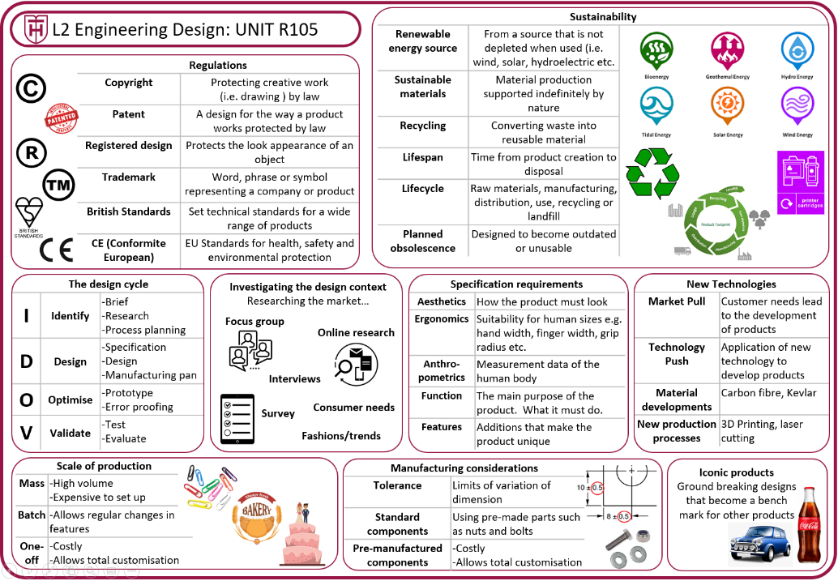
Using the knowledge organiser…

