Slide 1
METALS 2

Slide 2
What categories are metals divided into?
What are the most common metals?
What are the applications of metals?
Why are metals selected for different applications?
What factors influence the selection of metals?
Ferrous, Non Ferrous, Alloys, carbon content, Ferrous Alloys, Non Ferrous Alloys, cermets

Slide 3
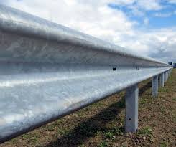
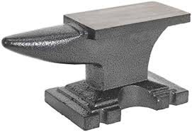
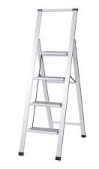
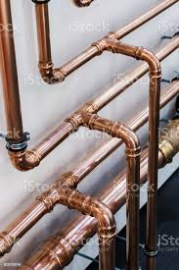
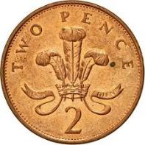
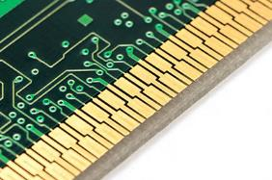
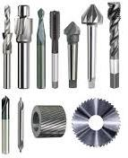
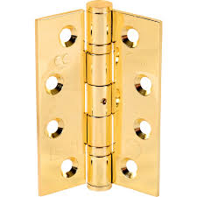
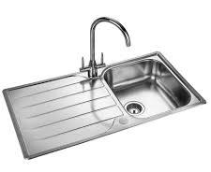
Here are a number of products made from metals.
How many of the metals can you name?

Slide 4
How well did you do?

Slide 5
How well did you do?
STEEL (ZINC PLATED)

Slide 6
How well did you do?

Slide 7
How well did you do?
CAST IRON

Slide 8
How well did you do?

Slide 9
How well did you do?
COPPER

Slide 10
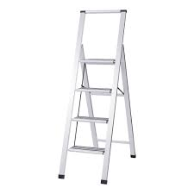
How well did you do?

Slide 11
How well did you do?
ALUMINIUM

Slide 12
How well did you do?

Slide 13
How well did you do?
TITANIUM

Slide 14
How well did you do?

Slide 15
How well did you do?
BRONZE

Slide 16
How well did you do?

Slide 17
How well did you do?
SILVER

Slide 18
How well did you do?

Slide 19
How well did you do?
STEEL

Slide 20
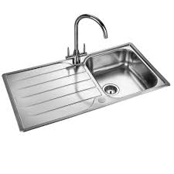
How well did you do?

Slide 21
How well did you do?
STAINLESS
STEEL

Slide 22
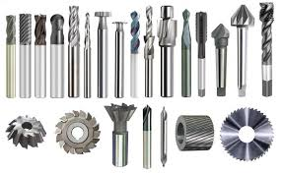
How well did you do?

Slide 23
How well did you do?
HIGH CARBON STEEL

Slide 24
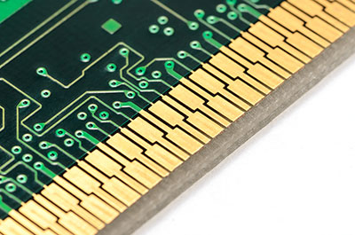
How well did you do?

Slide 25
How well did you do?
GOLD

Slide 26
How well did you do?

Slide 27
How well did you do?
BRASS

Slide 28
Which category of metals is missing from the list below?
Ferrous
Non-Ferrous
Ferrous Alloy
Non-Ferrous Alloy

Slide 29
Which category of metals is missing from the list below?
Ferrous
Non-Ferrous
Ferrous Alloy
Non-Ferrous Alloy
Cermet

Slide 30
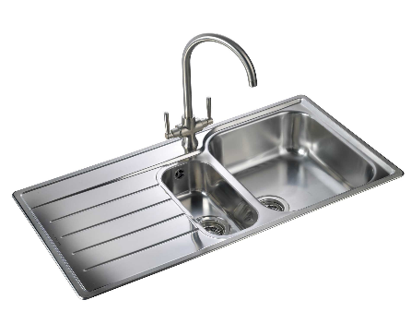
Which category is this metal in?
Ferrous
Non-Ferrous
Ferrous Alloy
Non-Ferrous Alloy
Cermet
Stainless steel

Slide 31
Which category is this metal in?
Ferrous
Non-Ferrous
Ferrous Alloy
Non-Ferrous Alloy
Cermet
Stainless steel

Slide 32
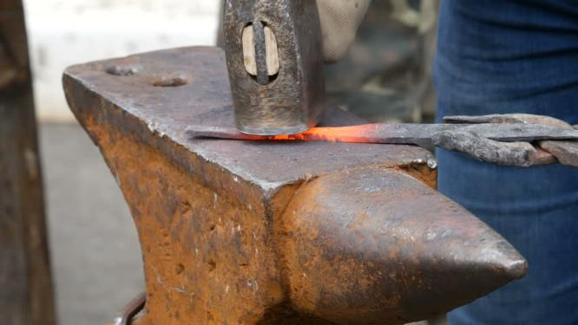
Which category is this metal in?
Ferrous
Non-Ferrous
Ferrous Alloy
Non-Ferrous Alloy
Cermet
Iron

Slide 33
Which category is this metal in?
Ferrous
Non-Ferrous
Ferrous Alloy
Non-Ferrous Alloy
Cermet
Iron

Slide 34
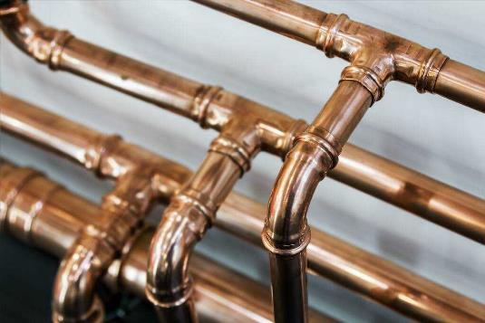
Which category is this metal in?
Ferrous
Non-Ferrous
Ferrous Alloy
Non-Ferrous Alloy
Cermet
Copper

Slide 35
Which category is this metal in?
Ferrous
Non-Ferrous
Ferrous Alloy
Non-Ferrous Alloy
Cermet
Copper

Slide 36
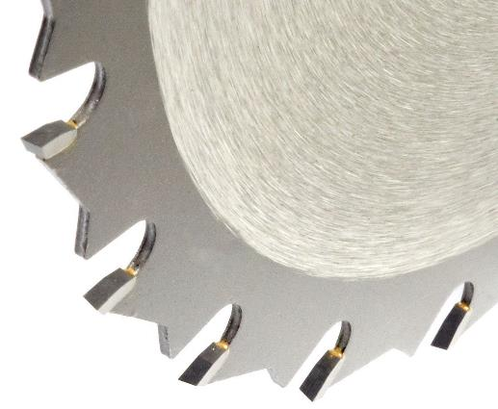
Which category is this metal in?
Ferrous
Non-Ferrous
Ferrous Alloy
Non-Ferrous Alloy
Cermet
Tungsten carbide

Slide 37
Which category is this metal in?
Ferrous
Non-Ferrous
Ferrous Alloy
Non-Ferrous Alloy
Cermet
Tungsten carbide

Slide 38
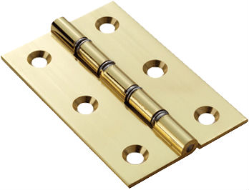
Which category is this metal in?
Ferrous
Non-Ferrous
Ferrous Alloy
Non-Ferrous Alloy
Cermet
Brass

Slide 39
Which category is this metal in?
Ferrous
Non-Ferrous
Ferrous Alloy
Non-Ferrous Alloy
Cermet
Brass

Slide 40
-Contain iron
-Rust
-Don’t contain iron
-Don’t rust
Ferrous
Non-Ferrous
What categories are metals divided into?
Non-Ferrous Alloys
Ferrous Alloys
-Combination of two or more non-ferrous metals
-Combination of two or more metals
-Include a ferrous metal
-Addition of non ferrous metals
Cermets
-Composite material
-Ceramic (cer) + metal (met)

Slide 41
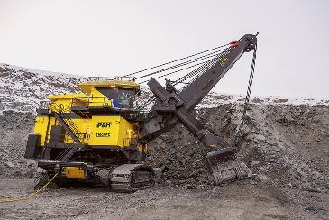
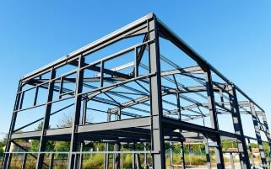
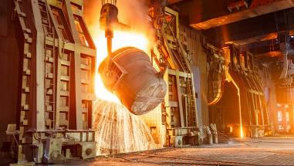
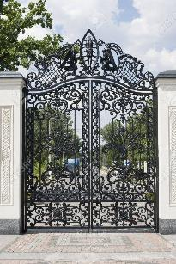
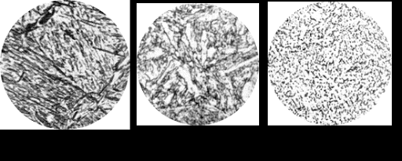
What is a Ferrous metal?
-Source: Ore…magnetite, haematite
-Mild steel:
-General engineering material
-Steel frameworks
-High carbon steel:
Hand tools, chisels, plane blades
-Properties: Ductility, Hardness, toughness, brittle
-Structure: Crystal, carbon content
-Cast and wrought iron
-Garden gate
-Stock forms: sheet, bar, tube and angle

Slide 42
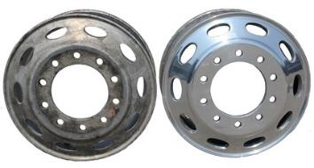
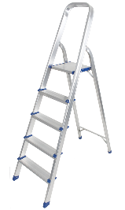
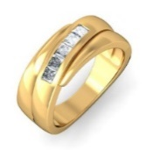
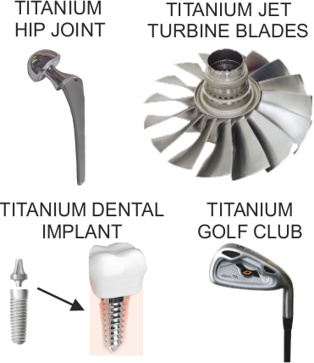
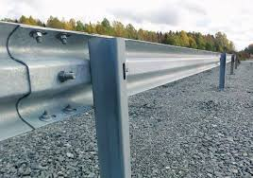
What is a Non-Ferrous metal?
-Source: Ore…
-copper-chalcopyrite
-aluminium-bauxite
-Oxidation,oxide
-Aluminium:
-Ladder, drinks cans,
food wrap.
-Titanium:
-Surgical applications
-Gold:
-Jewellery,
electrical contacts
-Zinc:
-Coating for steel
-Silver:
-High quality cutlery
-Copper:
-Domestic pipes, wire
Stock forms: sheet, tube, ingot

Slide 43
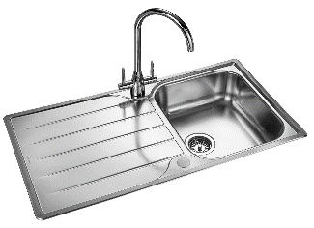
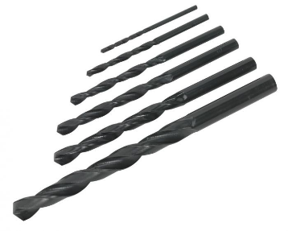
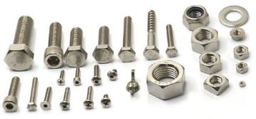
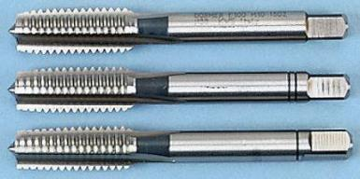
What is a Ferrous alloy?
-Stainless steel
(chromium, nickel, magnesium)
Uses: Sinks, cutlery.
-High speed steel
(tungsten, chromium, vanadium)
Uses: Cutting tools, drills.
-High tensile steel
(Nickel)
Use: Car engine components.
-Tool and die steel
(Chromium, manganese)
Uses: Press tools, extruder dies, blanking punches

Slide 44
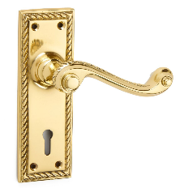
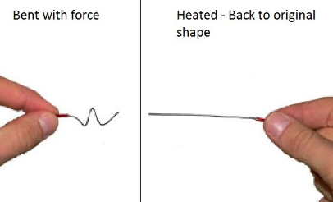
What is a Non-Ferrous alloy
-Combination of two or more non-ferrous metals
-Corrosion resistant
-Duralumin (aluminium, copper, manganese, magnesium)
Use: Structural aircraft components.
-Brass (copper, zinc)
Uses: Valves, taps, boat fittings, ornaments.
-Bronze (copper, tin)
Uses: Statues, coins, bearings.
-Nitinol (nickel, titanium)
Uses: Smart metal alloys – muscle wires, springs.

Slide 45
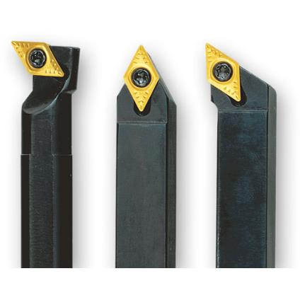
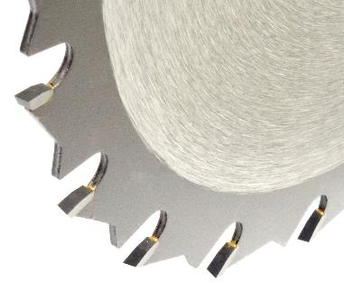
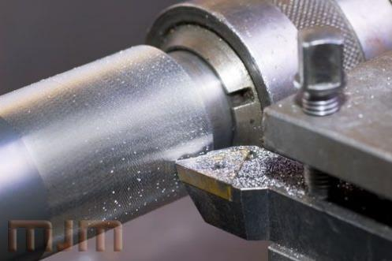
What is a cermet?
-Composite material
-Ceramic (cer) + metal (met)
-Best properties of both materials
-High temperature resistance and hardness of –ceramics
-ability to undergo plastic deformation of metal
Applications: Cutting tools

Slide 46
What resources are there to help me?
www.htdesigntech.com (password: htmember)

Slide 47
What do you know about metals?
How are metals selected?
Which categories are metals divided into?
How many metals can you name?
Can you suggest an application for each of the metals?
What are the properties of metals?
Why are metals selected for different applications?
What factors influence the selection of metals?
http://www.htrevisionzone.site/a_level_metals/

Slide 48
How can I test my understanding?
Revision quiz

