Slide 1
SCALES OF PRODUCTION

Slide 2
 | UNIT R105 TOPICS
1 | The phases of the design cycle
2 | Exploring the design cycle
3 | Influences on product design
4 | Product requirements
5 | Scales of production
6 | Stock forms and components
7 | Durability and tolerances
8 | Engineering drawings
9 | Engineering standards and symbols
10 | Environmental issues
11 | Using CAD in engineering
12 | Using CAM in engineering
13 | New and emerging materials
Which topic will be exploring in today’s lesson?

Slide 3
What are the scales of production?
Why are products manufactured at different scales?
Which production processes best suit each scale of production?
Manufacturer, supplier, customer, source, processing, transportation, logistics, demand, bespoke

Slide 4
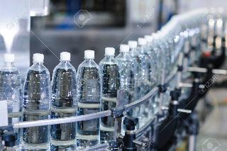
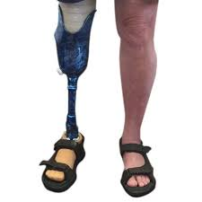
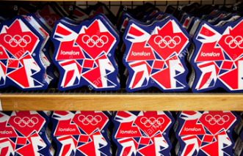
What quantity would the following products be manufactured in?
Rank them in order from the smallest to greatest quantity…
Bottled water
Prosthetic limb
Olympic merchandise
Drinking water

Slide 5
What quantity would the following products be manufactured in?
Rank them in order from the smallest to greatest quantity…
How did you do?
Prosthetic limb
Olympic merchandise
Bottled water
Drinking water

Slide 6
What do we mean by scale of production?
Scale of production relates to the way production methods change in relation to the quantity of a product being produced. Four terms are used to describe the different types…
One-off production
Batch production
Scale of production
Continuous production
Mass production

Slide 7
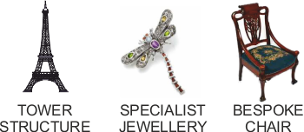
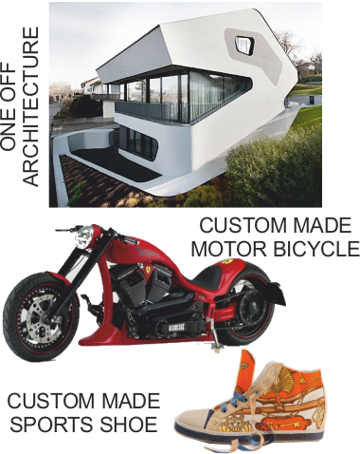
What is One-off production?
Single manufacture – one item
Can be custom made/ designed (bespoke manufacture)

Slide 8
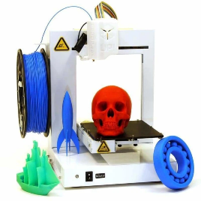
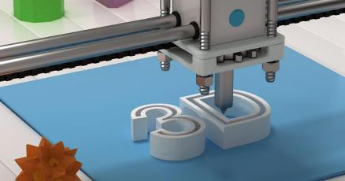
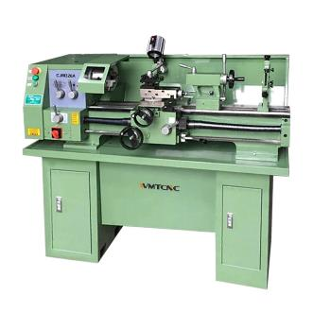
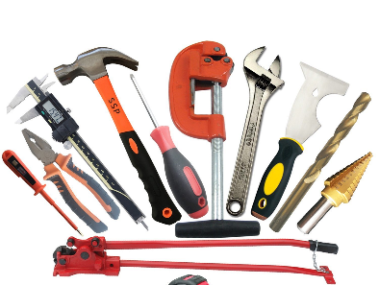
What types of process are appropriate for one-off production?
-3D Printing
-Manual machines
-Hand tools
-Smaller CAM machines
-Processes allow for full customisation and flexibility.
-Slower and more labour intensive processes result in a more expensive product.

Slide 9
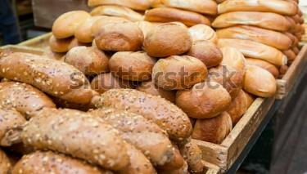
What is batch production?
Small quantity of identical items are made (10s-1000s)
Uses jigs, moulds and templates to aid workers
Batch of freshly baked bread…
Merchandise for events…
Special edition car…

Slide 10
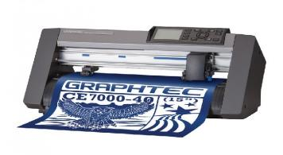
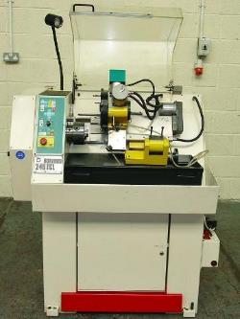
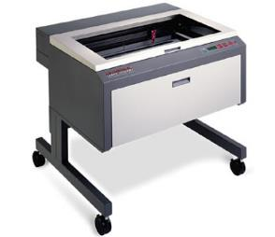
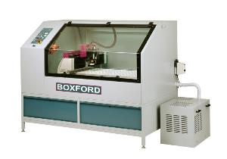
What types of process are appropriate for batch production?
-CAM Machines
-Laser cutting
-CNC Turning
-CNC Routing
-Processes allow for repeat manufacture.
-Design can be changed between batches.
-Greater accuracy and consistency.
-Relatively slow and only suited to small batches.

Slide 11
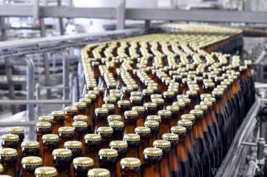
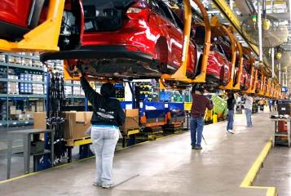
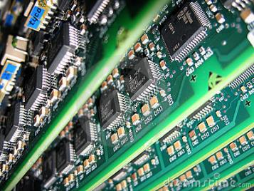
What is mass production?
Large quantities of products (10,000s-100,000s)
Assembly lines (for the main product) and sub-assembly (for small pieces and components)

Slide 12
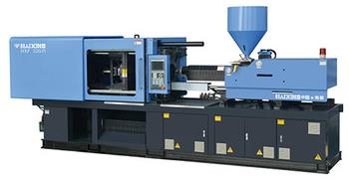
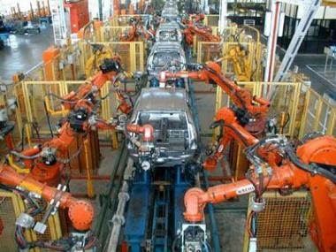
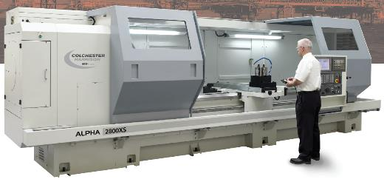
What types of process are appropriate for mass production?
-Injection moulding
-Large scale CAM machines
-Robotic assembly lines
-High speed production
-Greater accuracy and consistency
-Expensive to set up.
-Does not allow for customisation.
-Only suited to very large quantities.

Slide 13
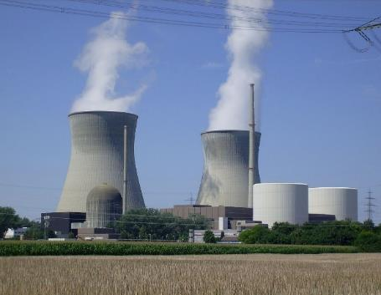
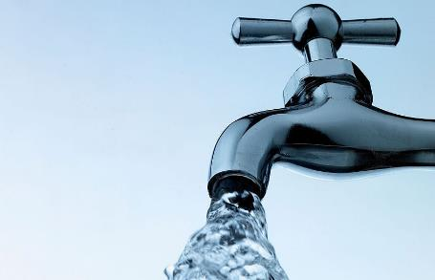
What is continuous production?
Large quantities of products (100,000s +)
Never ending production e.g. power plants

Slide 14
What does the term just-in-time (JIT) mean?
Products made to order
No need for warehouse space
Only order materials, etc when required
If timings are wrong/ orders are delayed there is a big financial impact

Slide 15
Can you match the product to the scale of production?
One-off production
Mass production
Batch production
Continuous production
Bottled water
Olympic merchandise
Drinking water
Prosthetic limb

Slide 16
What can you remember about the scales of production?
Have a go at this short quiz to see what you can remember…
https://htrevisionzone.site/l2_engineering_scales_of_production/index.html

