Slide 1
STANDARD COMPONENTS AND STOCK FORMS

Slide 2
 | UNIT R105 TOPICS
1 | The phases of the design cycle
2 | Exploring the design cycle
3 | Influences on product design
4 | Product requirements
5 | Scales of production
6 | Stock forms and components
7 | Durability and tolerances
8 | Engineering drawings
9 | Engineering standards and symbols
10 | Environmental issues
11 | Using CAD in engineering
12 | Using CAM in engineering
13 | New and emerging materials
Which topic will be exploring in today’s lesson?

Slide 3
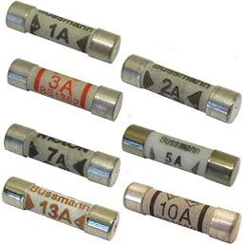
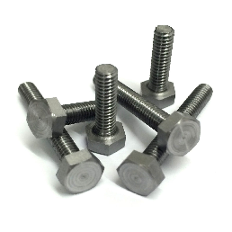
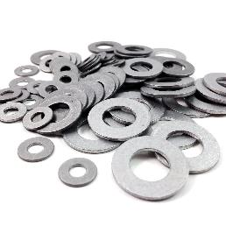
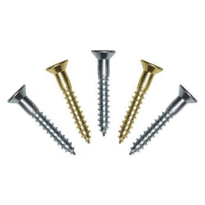
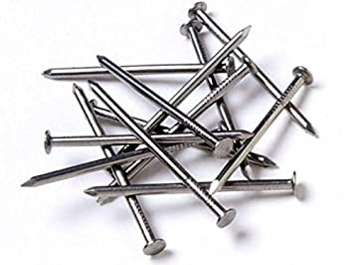
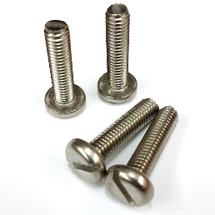
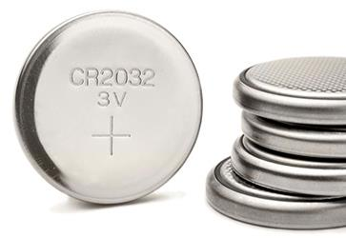
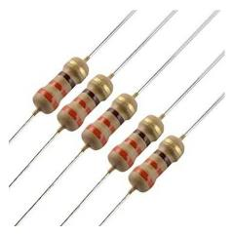
How many of these components can you name?
How did you get on?
Fuses
Bolts
Washers
Woodscrews
Nails
Machine screws
Coin cells
Resistors

Slide 4
What is a stock form?
What are the different stock forms?
What are the advantages and disadvantages of using stock forms?
What are standard components?
What are the benefits of using standard components?
Stock form, component, standardisation, accuracy, uniformity, mass production, wastage, transportation

Slide 5
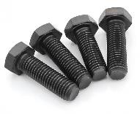
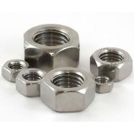
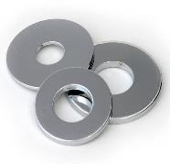
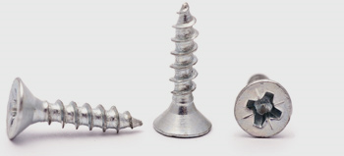
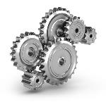
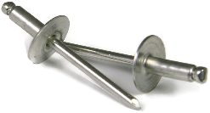
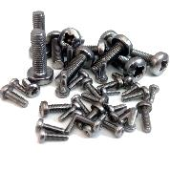
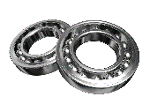
What is a standard component?
An individual part or component, manufactured in thousands or millions, to the same specification, usually manufactured to an internationally accepted standard.
What are examples of standard components?
Bolts
Nuts
Washers
Woodscrews
Gears
Bearings
Pop rivets
Machine screws

Slide 6
What are the advantages of using standard components?
ensures consistency
saves time and effort
less skill required by staff
less specialist equipment needed
can reduce costs
components bought in bulk

Slide 7
What are the disadvantages of using standard components?
less reliable - one manufacturer depends on another
components can be more expensive
large amount of storage space
time needed for ordering and delivery

Slide 8
What are standard components?
Watch this short video to find out more…
VIDEO LINK
(https://www.bing.com/videos/search?q=standard+components+in+engineering&&view=detail&mid=0DAC188EF90D865A4B470DAC188EF90D865A4B47&&FORM=VRDGAR&ru=%2Fvideos%2Fsearch%3Fq%3Dstandard%2Bcomponents%2Bin%2Bengineering%26FORM%3DHDRSC4)

Slide 9
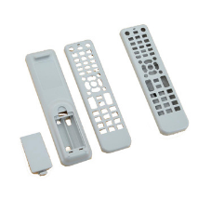
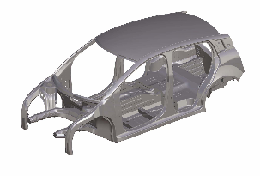
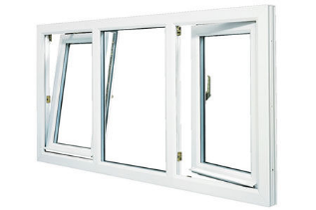
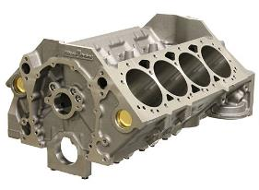
What is a pre-manufactured component?
These parts are usually made off-site by specialist manufacturers which can save time and improve quality.
Moulded product casings
Car body shell
Injection moulded chairs
PVC window frames
Cast engine parts

Slide 10
What are the advantages of using
pre-manufactured components?
Components don’t need to be manufactured on site.
Time can be saved in the assembly process.
Specialist manufacturers can be used leading to improved quality.
Less storage space is needed on site.
Parts can be delivered as needed.

Slide 11
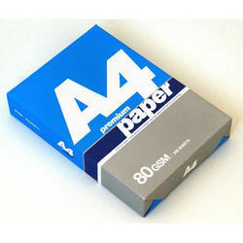
What is a stock form?
A ‘stock form’ is when a raw material has been machined/processed into a stock/standard size, shape or form. This can be easily used during manufacturing on a production line.
What is the stock form for paper and card?

Slide 12
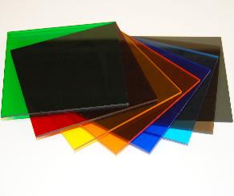
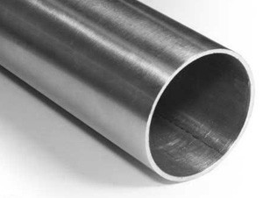
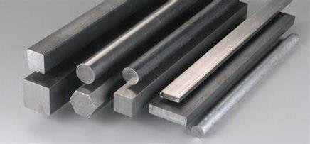
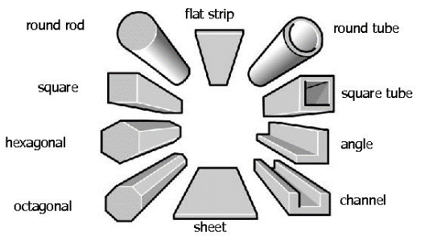
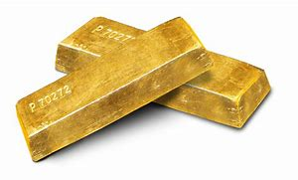
What are the types of stock form?
Sheet
Tube
Bar/rod
Stock forms of metal
Ingot

Slide 14
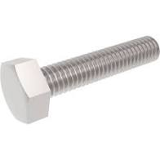
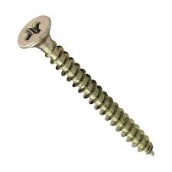
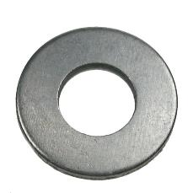
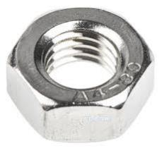
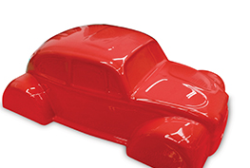
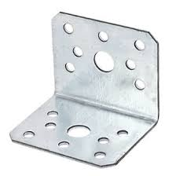
Which of these is NOT a standard component?
Bolt
Woodscrew
Washer
Nut
Plastic shell
Angle bracket

Slide 15
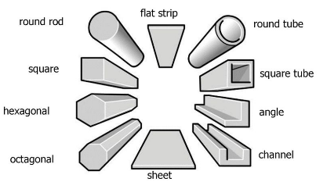
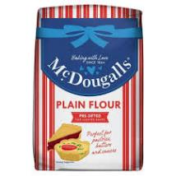
What standard forms are these materials available in?
A5/A4/A3 etc.
Thread, reel, woven sheet
Paper
Metal
Cotton
Milk
Flour
Acrylic
Pint
Kg
Sheet

Slide 16
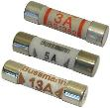
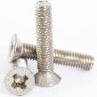
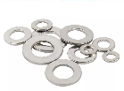
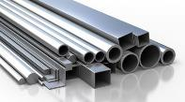
Answer these questions to see what can you remember about this topic?
Unit R105 – Standard components and stock forms revision task
1. What is a standard component?
3. Can you list 4 advantages of using standard components?
5. What is a stock form?
6. Can you name these common stock forms?
a)
b)
2. Can you name the following standard components?
7. Why do we use stock forms?
c)
d)
8. Can you give two advantages of using pre-manufactured components?
9. Metal is sold in a range of stock forms. Can you name any examples…
4. What is a pre-manufactured component?

Slide 17
What can you remember about standard components and stock forms?
Have a go at the quiz to check your understanding…
https://htrevisionzone.site/l2_engineering_standard_components/index.html

