Slide 1
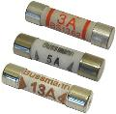
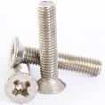
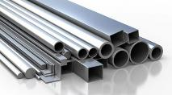
Unit R105 – Standard components and stock forms revision task
1. What is a standard component?
3. Can you list 4 advantages of using standard components?
5. What is a stock form?
6. Can you name these common stock forms?
a)
b)
2. Can you name the following standard components?
7. Why do we use stock forms?
c)
d)
8. Can you give two advantages of using pre-manufactured components?
9. Metal is sold in a range of stock forms. Can you name any examples…
4. What is a pre-manufactured component?

